Slide 1

SQL Server 2008 Functions
C3: Protected

Slide 2

About the Author
Created By: | Sucharita Das (241163) & Rajalaxmi (301159)
Credential Information: | 8+ years of SQL Server developer/architect experience
Version and Date: | SS2008/0611/1.0
Cognizant Certified Official Curriculum

Slide 3









Icons Used
Hands on Exercise
Questions
Tools
Coding Standards
Test Your Understanding
Reference
A Welcome Break
Contacts
Demonstration

Slide 4
Overview
What are functions?
Types of functions.
System-defined functions.
User-defined functions.
Types of user-defined functions.
Modifying a function.
Properties
When to use?
Limitations and Restrictions

Slide 5
Types of functions
User defined functions
System defined functions

Slide 6
System-defined functions
Built-in functions
System stored functions
Dynamic Management View and functions

Slide 7
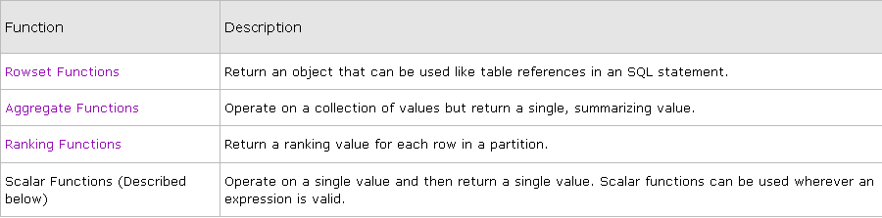
Built-In functions

Slide 8
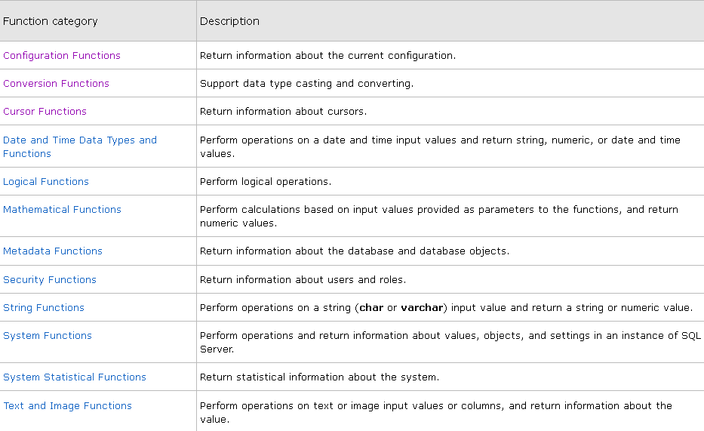
Scalar functions

Slide 9
User-Defined functions
A user-defined function is a database object that encapsulates one or more Transact-SQL statements for reuse.
They accept parameters, perform an action, such as a complex calculation, and return the result of that action as a value.
The return value can either be a single scalar value or a result set.

Slide 10
Types
Scalar functions
Inline Table-valued functions
Multi-statement Table-valued functions

Slide 11
Scalar Functions
A scalar function returns a single value of the data type referenced in the RETURNS clause of the CREATE FUNCTION statement.
The returned data can be of any type except text, ntext, image, cursor, or timestamp.

Slide 12
SYNTAX
CREATE FUNCTION [ schema_name. ] function_name
( [ { @parameter_name [ AS ][ type_schema_name. ] parameter_data_type
[ = default ] [ READONLY ] }
[ ,...n ]
])
RETURNS return_data_type
[ WITH <function_option> [ ,...n ] ]
[ AS ]
BEGIN
function_body
RETURN scalar_expression
END
[ ; ]

Slide 13
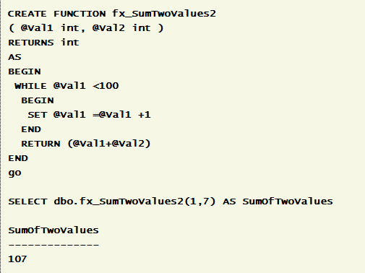
Eg

Slide 14
Inline Table-Valued Functions
An inline table-valued function returns a variable of data type table whose value is derived from a single SELECT statement.
There is no BEGIN/END block needed in the CREATE FUNCTION statement.
There is also no need to specify the table variable name.

Slide 15
Syntax
--Transact-SQL Inline Table-Valued Function Syntax
CREATE FUNCTION [ schema_name. ] function_name
( [ { @parameter_name [ AS ] [ type_schema_name. ] parameter_data_type
[ = default ] [ READONLY ] }
[ ,...n ]
]
)
RETURNS TABLE
[ WITH <function_option> [ ,...n ] ]
[ AS ]
RETURN [ ( ] select_stmt [ ) ]
[ ; ]

Slide 16
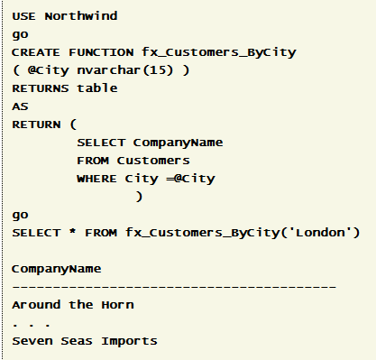
Eg

Slide 17
Multi-statement Table valued function
It uses multiple statements to build the table that is returned to the calling statement.
Unlike inline function, table variable has to be explicitly defined.

Slide 18
SYNTAX
CREATE FUNCTION [ schema_name. ] function_name
( [
{ @parameter_name [ AS ] [ type_schema_name. ] parameter_data_type [ = default ] [READONLY] } [ ,...n ]
] )
RETURNS @return_variable TABLE <table_type_definition>
[ WITH <function_option> [ ,...n ] ] [ AS]
BEGIN
function_body
RETURN
END [ ; ]

Slide 19
Modify a function
-- Scalar-Valued Function
USE [AdventureWorks2012]
GO
ALTER FUNCTION [dbo].[ufnGetAccountingEndDate]()
RETURNS [datetime]
AS
BEGIN
RETURN DATEADD(millisecond, -2, CONVERT(datetime, '20040701', 112));
END;

Slide 20
Delete
-- determines if function exists in database
IF OBJECT_ID (N'Sales.fn_SalesByStore', N'IF') IS NOT NULL
-- deletes function
DROP FUNCTION Sales.fn_SalesByStore;
GO

Slide 21
Executing
Scalar:
select dbo.fn_name()
Table-Valued
select * from fn_name()

Slide 22
Properties
Determinism
Deterministic functions always return the same result any time they are called with a specific set of input values and given the same state of the database.
Nondeterministic functions may return different results each time they are called with a specific set of input values even if the database state that they access

Slide 23
Properties
Precision
A user-defined function is said to be precise if it does not involve any floating point operations.
Data Access
This property indicates whether the function accesses the local database server using the SQL Server in-process managed provider
System Data Access
This property indicates whether the function accesses system metadata in the local database server using the SQL Server in-process managed provider.

Slide 24
Properties
IsSystemVerified
This property indicates whether the determinism and precision properties of the function are verifiable by the Database Engine.
This property is true for Transact-SQL functions as long as they do not call any functions marked IsSystemVerified = false.

Slide 25
When to Use?
In Transact-SQL statements such as SELECT
In applications calling the function
In the definition of another user-defined function
To parameterize a view or improve the functionality of an indexed view
To define a column in a table
To define a CHECK constraint on a column
To replace a stored procedure

Slide 26
Limitations and Restrictions
User-defined functions cannot be used to perform actions that modify the database state.
User-defined functions cannot contain an OUTPUT INTO clause that has a table as its target.
The following Service Broker statements cannot be included in the definition of a Transact-SQL user-defined function:
BEGIN DIALOG CONVERSATION
END CONVERSATION
GET CONVERSATION GROUP
MOVE CONVERSATION
RECEIVE
SEND

Slide 27
Cont..
Nesting
User-defined functions can be nested; that is, one user-defined function can call another.
User-defined functions can be nested up to 32 levels.
Certain non-deterministic functions can be used inside user-defined functions.
GETDATE
@@MAX_CONNECTIONS
Certain non-deterministic functions can be used inside user-defined functions.
NEWID
RAND

Slide 28
Test Your Understanding
What are functions?
What are the types of functions?

Slide 29
SUMMARY
SQL Server 2008 allows creation of scalar and table valued functions.
Functions should end with RETURN statement.
Functions cannot alter the state of the database or SQL Server instance.

Slide 30

You have successfully completed SQL Server 2008 VIEWS

